Slide 1
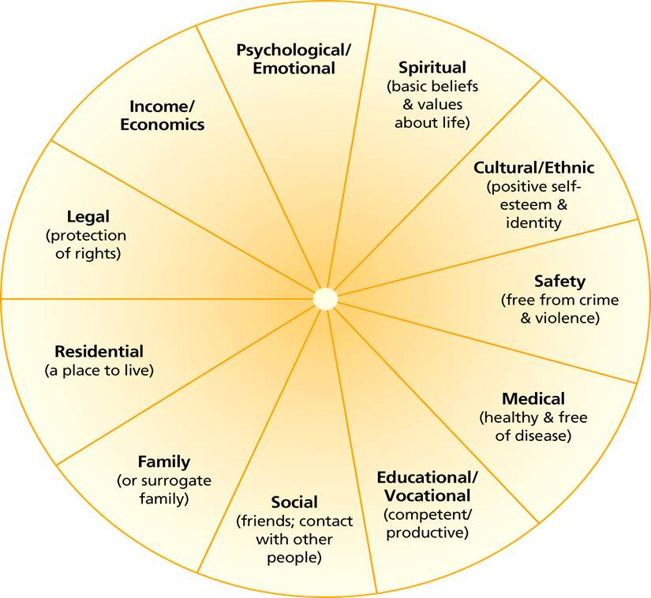
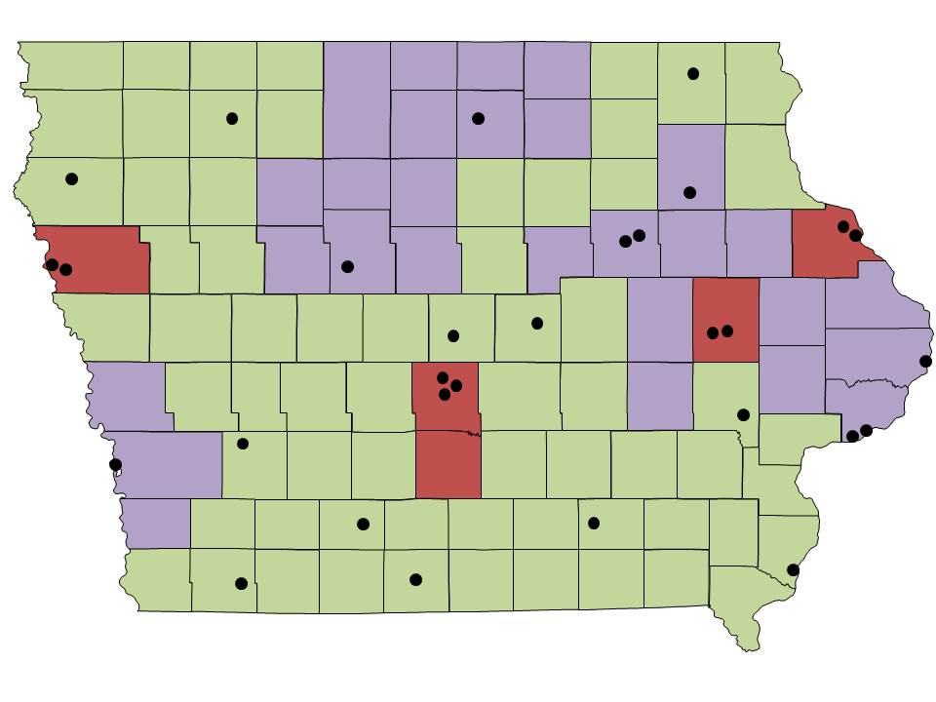
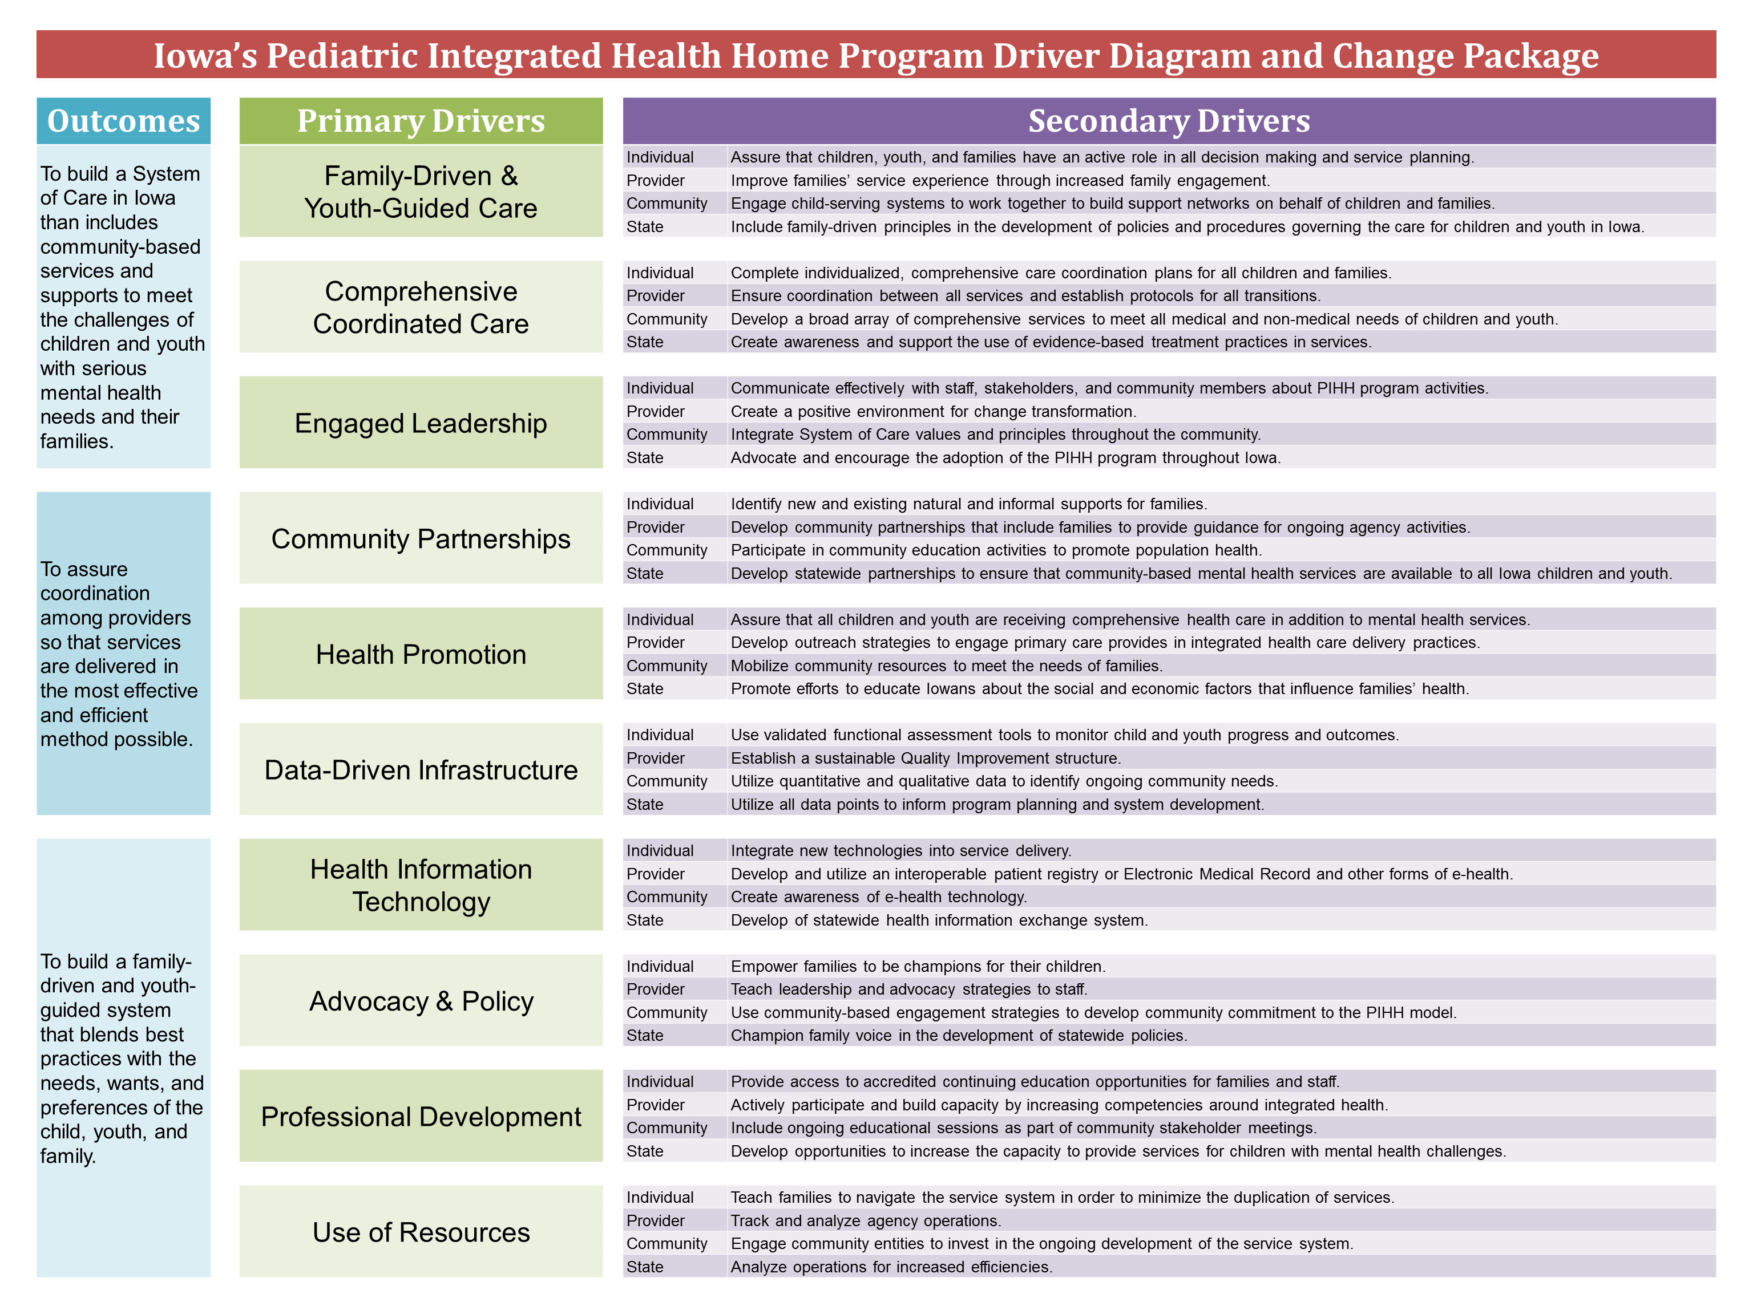
Children’s Mental Health Systems Integration: A System of Care Approach
Debra Waldron, MD, MPH, FAAP; Vice-Chair of Health Policy, Professor of Pediatrics
Vickie Miene, MS, MA, LMHC; Executive Director, Center for Child Health Improvement & Innovation
University of Iowa Children’s Hospital
CHILDREN’S MENTAL HEALTH
SYSTEM OF CARE
LESSONS LEARNED
OUTCOMES
One in five children, ages birth to 18 years old has a diagnosable mental health disorder; one in ten children has a mental health challenge that is severe enough to impair their functioning at home, in school, or in the community.¹
This makes mental health the costliest condition of childhood ($8.9 billion per year).²
Traditionally, mental health services for children and youth have been delivered in silos, fragmented, and driven by professionals, not families.
Services varied statewide and access was limited by community and family resources.
A System of Care (SOC) is a coordinated network of community-based services and supports organized to meet the challenges of children and youth with mental health needs and their families.
The SOC framework recognizes the importance of family, school, and community and seeks to promote the full potential of every child by addressing their physical, emotional, intellectual, cultural, and social needs.
An integral part of the PIHH Program is the development of a Care Coordination Plan that includes information about the child and family’s strengths, dynamics, traditions, and culture, along with areas of need.
The Life Domains Areas of Assessment (adapted from VanDenBerg and Burchard, 1990) is used to build these plans.
The shift from an individualized case management model of service delivery to one of a team-based, multidisciplinary coordinated care model is a significant change and challenge for organizations implementing the program.
Impacts on communication, documentation, supervision, organizational structure, and process have been noted.
Quality Improvement processes are a new concept for many providers. Agencies with experience managing change have been more successful in the early phases of the program.
Sites who have dedicated positions for leadership, data collection, and data reporting have been more successful in overall implementation.
Agencies are better understanding the skills needed to assess and hire employees that are a good fit for the program. This process has been challenging in more rural areas of Iowa where employees that meet the necessary qualifications may not be available.
Community collaboration has successfully formed in some areas of the state where there is more than one PIHH provider. Agencies have combined resources to hold family events and community education forums, while maintaining their individual agency identities.
The philosophical training related to SOC values is best implemented once new staff have been oriented to their agency and have some experience working in the field.
Data are collected every three months for all enrolled children and families using the Quarterly Caregiver Survey (QCS). This instrument is used to assess child and family functioning in seven life domains: Medical, Family, Legal, Psychological, School, Economic, and Residential.
Based on survey results, children are placed into one of three tiers: Mild, Moderate, or Severe.
Between July 1, 2013 and June 30, 2014, baseline and follow-up data were collected for 3158 enrolled children and youth. A generalized mixed model analysis was used to determine probability of each domain flagged and tier level for each member over time. The percentages in each of the following charts are based on this analysis; all results are statistically significant.
INTEGRATED HEALTH
The Iowa Pediatric Integrated Health Home Program (PIHH) is for children and youth, 0 to 18 years old, who are Medicaid eligible and have a Severe Emotional Disorder (SED) that includes a functional impairment.
The PIHH Program expands traditional health care to:
Develop local Systems of Care
Enhance coordination of behavioral and physical health
Strengthen individual and family supports
Promote the Wraparound approach
Program activities include:
Family to family peer support services
Community engagement and health promotion activities
Care coordination
Building linkages to community supports
Strengthening partnerships with primary care providers
As of July 1, 2014, 30 agencies are providing services to children, youth, and their families across the state of Iowa.
QUALITY IMPROVEMENT
The Quality Improvement Driver Diagram and Change Package uses the Science of Improvement methodology to weave SOC values and principles throughout individual agency and state system practices. Each primary driver has four secondary drivers that encompass the domains of family, provider, community, and state level activities.
MULTIDISCIPLINARY TEAM
The PIHH Program uses a multidisciplinary team to coordinate care for children and families.
Care Coordinators help families access community-based services and supports, facilitate communication among health care providers and work with families and other team members to develop a comprehensive care coordination plan.
Family Peer Support Specialists have first-hand experience as a parent or caregiver of a child with a behavioral, emotional, or mental health challenge. They provide family to family support and have unique knowledge of available resources in their community.
Nurses help with medication management, promote healthy behaviors, and provide special attention to children and youth with complex medical needs.
1. National Center for Children in Poverty, 2011
2. AHRQ Research Brief #242, 2009
Funding from the Iowa Department of Human Services through its contract with Magellan Behavioral Care of Iowa for the Iowa Plan.
Presented at the Children’s Hospital Association Annual Leadership Conference: October 12-14, 2014; Palm Desert, CA

